Slide 1
Heat Pump Deployment Priority Analysis
Gamze Bozkurt Omar
25th of September 2025

Slide 2
INTRODUCTION
Research Question
"Which local authorities should be prioritized for heat pump funding under different policy goals?"
The Challenge
The UK government plans to roll out heat pumps at scale.
Funding is limited, so resources must be targeted carefully.
An evidence-based approach is needed to decide where investment will have the biggest impact.
Our Approach
Built a scoring system using multiple criteria (equity, carbon, market readiness).
Analyzed EPC data from over 324 local authorities in England.
Tested three policy scenarios to show how priorities shift.

Slide 3
DATA overview
Coverage:
324 local authorities
~26.9 million properties
Energy Ratings (EPC):
Majority in C (17k) and D (21k) bands
Very few at A (214) or G (477)
Fuel Types:
Strong reliance on mains gas (46k+)
Smaller share on electricity (2.3k) and community gas (1k)
Property Types:
Mostly Houses (38k)
Followed by Flats (9k) and Bungalows (4.7k)
Very few maisonettes or park homes
Data Quality:
Indicative cost has missing values
Other columns show no duplicates and only very small % missing data

Slide 4
methodology
The weighted scoring model (a specific implementation of MCDA) is a commonly used tool for prioritization and decision support.
Equity-focused: 50% equity, 25% carbon, 25% uptake.
Carbon-focused: 25% equity, 50% carbon, 25% uptake.
Market-readiness: 25% equity, 25% carbon, 50% uptake.
Equity Score % of rented/social homes with high heating costs.
higher percentage = more households struggling with energy bills → stronger case for support.
Carbon Score % of homes using fossil fuels.
higher percentage = bigger potential carbon savings if these homes switch to heat pumps.
Uptake Score % of homes owner-occupied (higher likelihood to invest in upgrades).
owner-occupied homes are easier to retrofit than rented ones (no landlord-tenant barrier), so higher percentage = more “ready to go” households.

Slide 5
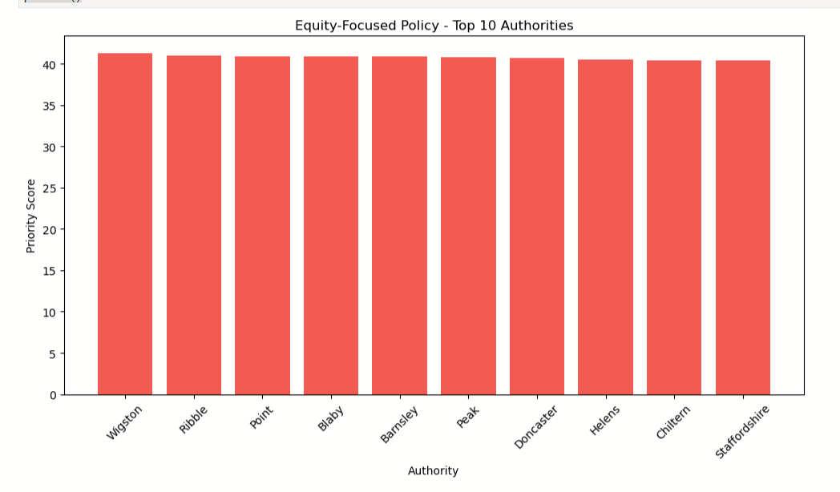
TRENDS AND INSIGHTS
The top 10 equity-focused areas all score very close, showing fuel poverty is a shared issue rather than one concentrated in a single authority.

Slide 6
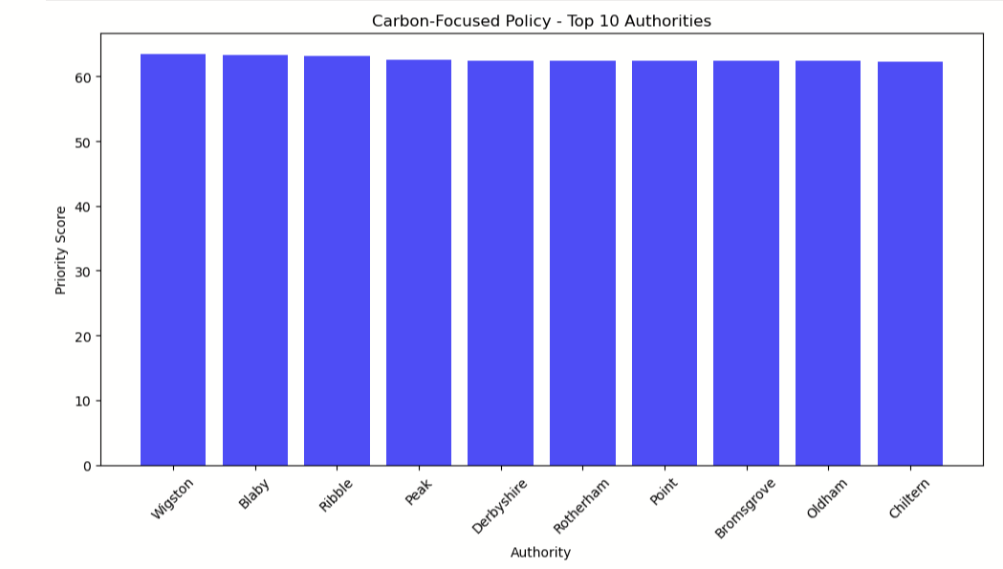
TRENDS AND INSIGHTS
All top areas score very close, meaning fossil fuel heating is common everywhere. Carbon savings are possible across many regions, not just a few.

Slide 7
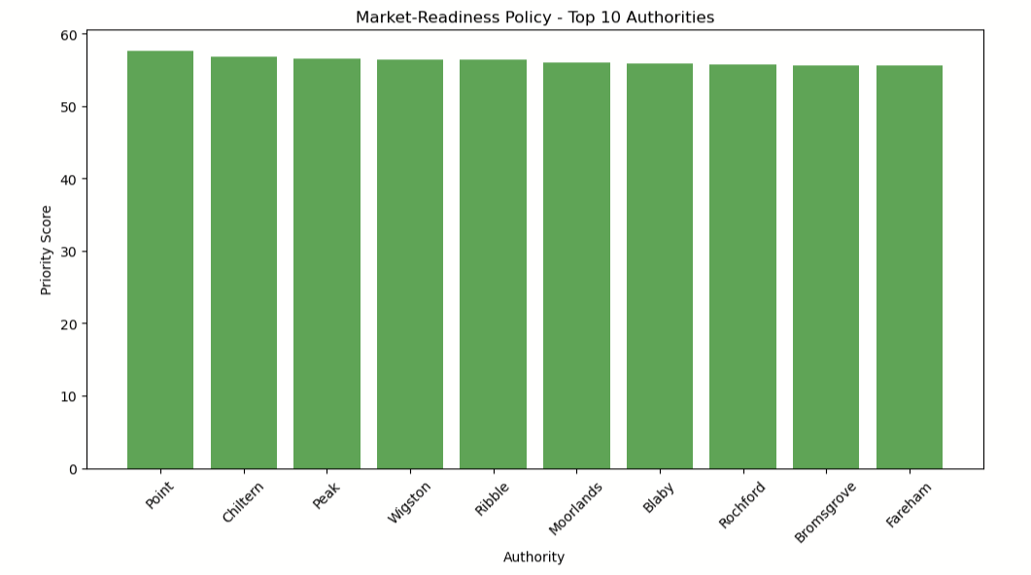
TRENDS AND INSIGHTS
The top authorities all score very close together. This means owner-occupied homes, which are easier for heat pump rollout, are spread fairly evenly across regions.

Slide 8
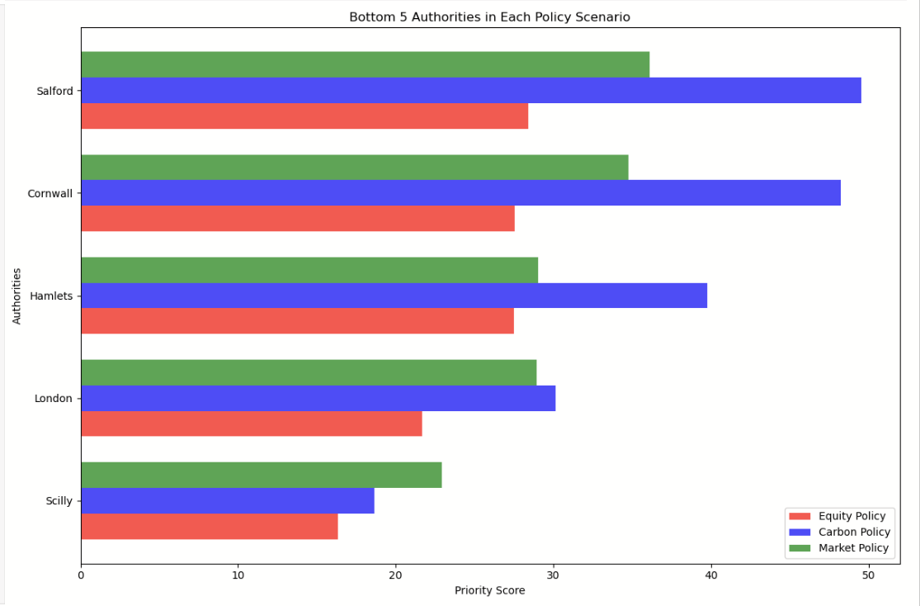
TRENDS AND INSIGHTS
These are the bottom 5 authorities under different policy scenarios. Their scores are much lower, meaning they are less suitable for immediate rollout. They may face higher costs, lower uptake, or fewer carbon benefits, so they would likely need more preparation before heat pump funding.

Slide 9
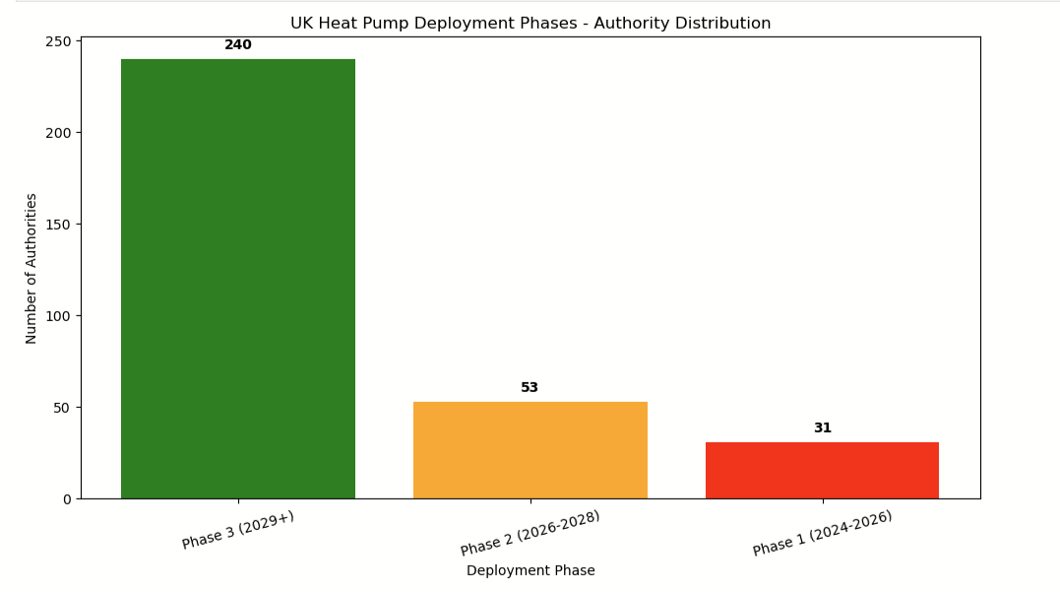
TRENDS AND INSIGHTS
Priority scores = average of Equity, Carbon, and Uptake scores.
We split authorities into phases using score percentiles:
Phase 1 (2024–2026): Top 10% (score ≥ 51.2)
Phase 2 (2026–2028): Next 15% (50.0–51.2)
Phase 3 (2029+): Remaining (score < 50.0)
Most authorities fall into Phase 3, meaning they will need more preparation before rollout.

Slide 10
Conclusion
The same authorities (like Wigston, Ribble, Peak, Blaby, Chiltern) appear at the top across all scenarios, strong early candidates.
Interestingly, even London, despite being a large urban authority, shows up in the lowest 5 under scenarios. This highlights how scale doesn’t always mean readiness.
The phase breakdown shows only a handful of places are truly ready now, with most needing more time and support before rollout.
The smart move is to start with the clear front-runners, build success stories there, and then scale up as more regions become ready.

Slide 11
Data LIMITATION
Coverage: EPCs are only required when homes are built, sold, or rented so many older homes are missing.
Timing: Certificates are valid for 10 years, so some data is outdated and may not reflect current conditions.
Completeness: After cleaning, EPCs cover only about half of UK homes.
Quality Issues:
Retrofit cost fields often missing.
Fuel types written inconsistently (e.g. multiple names for gas).
Weighting: The 50%-25%-25% scoring split is logical but still subjective so different weights could change rankings.
Implication: EPC data is valuable but incomplete. Findings should be seen as guidance, not absolute truth.

Slide 12
Future work
Regional analysis: Some folder naming issues meant we could only cluster 186 authorities into regions. With better cleaning, all 324 could be grouped, allowing stronger region-based insights.
Funding data: Adding information on government funding at local levels would improve fairness in prioritisation.
Deployment costs: Including actual heat pump installation costs for homes and flats would make the analysis more realistic.
These steps would help produce more accurate, fair, and practical insights for policymakers.

Slide 13
References and Sources
Github Repo link:
https://github.com/gamzebb/Heat-Pump-Analysis/tree/main
EPC Data Source link:
https://epc.opendatacommunities.org/login
UK Heat Pump Net Zero Investment Roadmap Plan link:
https://www.gov.uk/government/publications/heat-pump-net-zero-investment-roadmap
Data Constraints:
https://www.ons.gov.uk/peoplepopulationandcommunity/housing/articles/energyefficiencyofhousinginenglandandwales/2024
https://www.theguardian.com/money/article/2024/jun/18/energy-performance-certificates-unreliable-which-epc
The weighted scoring model (a specific implementation of MCDA):
https://productschool.com/blog/product-fundamentals/weighted-scoring-model

Slide 14
Thank You

